Slide 1

Log File Management
Unification for Improving Efficiency
(Vs. 1.1 – Aug-2016)

Slide 2
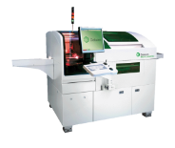

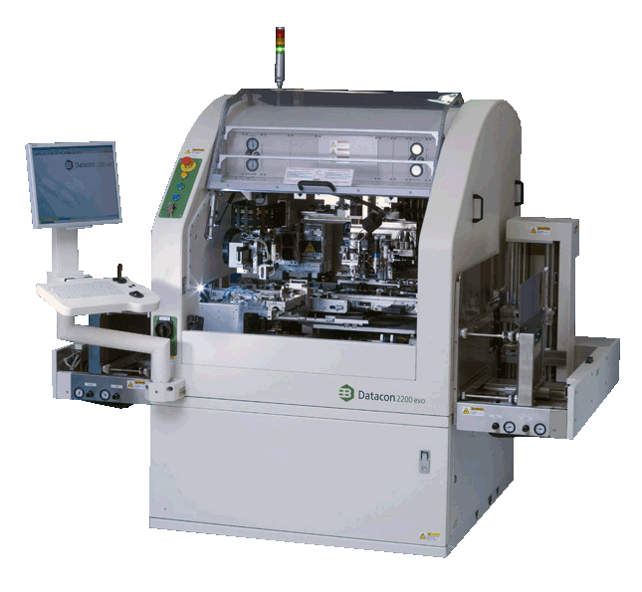

Unification to Improve Efficiency
1) Efficient Diagonsis, Analysis, Debugging
to support efficient analysis/diagnosis/debugging of machine capabilities (e.g., accuracy, temperature, force, TC process, …)
to provide an obligatory SW specification for log file management (every non-compliance is defined as a bug and has to be fixed)
MATLAB is considered as the preferred analysis tool, thus a major goal is to allow log file import into MATLAB with one single universal import function.
2) Efficient Organization & Information Transfer
to define a unified file organization, which allows efficient transfer (automatic, semi-automatic, manual transfer) of log file packages between machines, personal computers and data bases.

Slide 3
A Huge Project? Tremendous Efforts?
Log file management is concerning a huge field of application areas
R&D tasks
field support
serial production
other application areas
To implement a log file management for all application areas requires tremendous efforts
tremendous definition and alignment efforts
tremendous implementation efforts
To move forward a step-by-step approach for both definition and implementation is required. A layer organization of the log file management system supports a step-by-step approach.

Slide 4
Definition & Implementation in Layers
Log File Management Structure
R&D tasks
format
Core Layer
log file format
file system organization
specifics
log file
format
2) Specifics Layer
format specifics
organization specifics
field support
serial production
file system
organization
organization
3) Application Layer
R&D tasks
field support
serial production
other applications
specifics
other applications

Slide 5
Proposed Step-by-Step Approach
Phase 1
Define a core log file management system comprising core format and core file organization
Setup a log file management key group
Align core definitions with key group
First alpha test
Phase 2
Define log file format specifics with key group
Each new logging has to be implemented according to core format and format specifics
Phase 3
Define file organization with key group
Implement log file management dialogs in machine SW (library)
Each new logging has integrated log file dialogs
Phase 4
Case-by-case backward integration of log file management
Case-by-case implementation of data base functionality

Slide 6
Log File Format
Definition
Core Format
Format specifics (proposal)

Slide 7
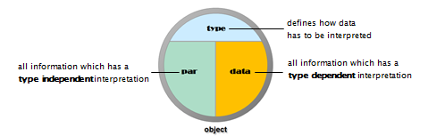
Information Structure of a Log File
Log files contain a bulk of information which can typically be categorized as follows
type: tells us how data has to be interpreted
parameter: information which has a type-independent interpretation (like title, comments, date, time, rows, columns, machine-ID, …)
data: all information which has type dependent interpretation

Slide 8
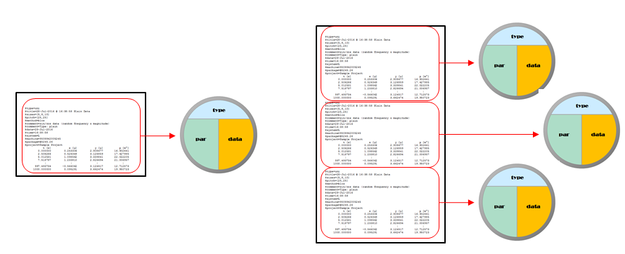
Object Structure of a Log File
A log file may be organized into log file chunks, which are called log objects
Each log object refers to type, parameter and data of a particular test (figure 3).
At the core definition level there is some freedom whether a sequence of log file information chunks is logged into a single log file as a sequence of log file objects, or each part of the sequence is logged into a distinct log file representing only a single object

Slide 9
Log File Syntax
Log files have to be represented by readable text files
A log file body contains one or more log objects
log file
log object
A log object contains optional parameters, an obligatory header and one or more data lines
parameter
log object
header
data line
Comment lines can be placed at any line position of the log file. A comment line starts with a ‘%‘ character, proceeded by any characters (zero or more)

Slide 10
Log File Examples
$type=uni
$title=28-Jul-2016 @ 16:38:58 Plain Data
$sizes=[5,8,10]
$pitch=[25,25]
$method=blcs
$comment=sin/cos data (random frequency & magnitude)
$comment=Type: UNI
$date=28-Jul-2016
$time=16:38:58
$system=L
$machine=9508842005245
$package=@5245.26
$project=Sample Project
t [s] x [µ] y [µ] p [m°]
0.000000 0.253306 2.908677 16.902641
5.012531 1.098562 3.339841 22.022205
7.518797 1.233810 2.826694 21.006957
: : : :
1000.000000 0.095291 3.662474 19.950723
$type=uni
$title=28-Jul-2016 @ 16:38:58 Plain Data
$sizes=[5,8,10]
$pitch=[25,25]
$method=blcs
$comment=sin/cos data (random frequency & magnitude)
$comment=Type: UNI
$date=28-Jul-2016
$time=16:38:58
$system=L
$machine=9508842005245
$package=@5245.26
$project=Sample Project
; t [s]; x [µ]; y [µ]; p [m°];
; 0.000000; 0.253306; 2.908677; 16.902641;
; 2.506266; 0.526349; 3.126859; 17.427985;
; 5.012531; 1.098562; 3.339841; 22.022205;
: : : :
; 1000.000000; 0.095291; 3.662474; 19.950723;
a) log file format with standard syntax
b) log file format with alternative syntax
$type=uni
$title=28-Jul-2016 @ 16:38:58 Plain Data
%
% these are three comment lines
%
$comment=sin/cos data (random frequency & magnitude)
$comment=Type: UNI
$date=28-Jul-2016
$time=16:38:58
$system=L
$machine=9508842005245
$package=@5245.26
$project=Sample Project
%
% the data header is a sequence of symbols followed by the unit in brackets
%
t [s] x [µ] y [µ] p [m°]
0.000000 0.253306 2.908677 16.902641
997.493734 -0.566062 3.124517 12.712573
: : : :
1000.000000 0.095291 3.662474 19.950723
c) log file format including comments

Slide 11
More Syntax Details
parameter
$
identifier
=
value
identifier
[
unit
]
header
separator
identifier
[
unit
]
separator
datarow
data
separated datarow
datarow

Slide 12
Log File & Folder
Organization
Core Organization
Organization specifics (proposal)

Slide 13
Basic Organization Structure
Log files are always contained in log packages (simply: packages)
Packages are (uniquely) identified by a package ID.
The package ID starts with a ‚@‘ character followed by the last for digits of the machine number plus a continued number separated by a period (e.g. @4567.28 or @2377.2)
A package is represented as a folder with a specific naming syntax that contains one or more log files, optionally supported with additional files.
The naming syntax of a package name is
The text must comply to allowed file name characters
Examples: @4567.28.VIB Vibration tests left&right, @4567.28.MBC
package ID
@
fourdigits
.
integer
.
package name
package ID
.
type
text
_

Slide 14

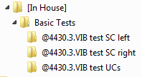


Log File Types
There is a unique (extendable) list of type identifiers
If a log file contains information of multiple log objects, all log objects must be of the same type
A package folder can only contain log files of the same type, which has to match the type information incorporated in the package folder name
Example
contains
contains
contains

Slide 15
Project Context Transition
initial
context
new project
new project
open project
new package
default
context
open project
project
context
run a test
close project
run a test

Slide 16
Project Context Control
begin test
no
yes
project context
parent folder
for new package folder
is type subfolder
of log root
parent folder
for new package
folder is current
project folder
test type
changed?
create new package
folder in proper
parent folder
perform test and log data
end test

Slide 17
Appendix

